Slide 1


WATCHERA
E-Commerce Website of Watches
Presented By:
Bhingradia Fenil (6756) | Savsani Ronak (7191) | Avaiya Nand (6730)
Guided By: Prof. Disha Nalwala
SDJ International College, Vesu
BCA Sem VI | A.Y. 2025-26
Welcome to our final year BCA presentation on WATCHERA, developed under the guidance of Prof. Disha Nalwala at SDJ International College.

Slide 2

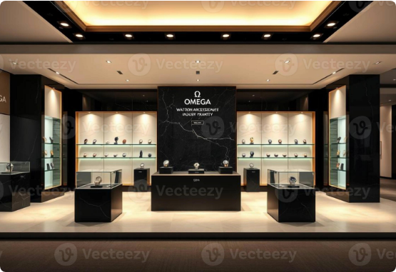
Introduction to WATCHERA
WATCHERA is a premium e-commerce platform designed to provide a secure, seamless, and sophisticated online shopping experience for luxury timepieces.
▪
Transitions the elite boutique experience into a responsive digital space.
▪
Allows customers to confidently browse, evaluate, and purchase high-end watches.
▪
Built on a modern, robust architecture ensuring fast performance and transaction integrity.
▪
Separated module structure ensures secure operations across different access levels.
Watchera bridges the gap between traditional luxury boutiques and modern web convenience, offering a premium digital storefront for watch enthusiasts.

Slide 3







Problem Statement
Geographical Limits
Clunky UX & Performance
Rigid Inventory
Physical stores restrict sales to local areas and specific operating hours, severely limiting market reach for luxury brands.
Outdated relational databases struggle to adapt to new watch types with different technical specs, requiring time-consuming restructuring.
Traditional multi-page websites suffer from slow load times and poor mobile optimization, breaking the immersive feel expected by buyers.
The luxury watch industry relies on outdated physical models or generic web templates that fail to capture the exclusivity expected by high-end buyers.

Slide 4
Project Objectives
Secure Authentication: Implement strict JWT sessions and bcrypt encryption to protect sensitive customer data.
High Performance: Guarantee fast page load times under 3 seconds using asynchronous processing and SPA rendering.
Role Segregation: Create dedicated, secure modules for Customers, Staff, and Administrators to streamline operations.
Responsive Design: Deliver a flawless, mobile-first shopping experience utilizing utility-first CSS frameworks.
Business Analytics: Provide real-time data tracking for sales, inventory, and revenue to assist administrative oversight.
Our main goals were security, speed, and usability. We aimed to build a platform that protects user data while delivering a seamless, app-like experience.

Slide 5


Scope of the Project
Admin / Owner Scope
Customer Scope
Serving as the central command center with absolute control over backend operations:
Delivering a frictionless, premium shopping journey focusing on discovery:
▪
Real-time dashboard analytics (revenue, orders).
▪
Advanced dynamic filtering without page reloads.
▪
Full Catalog Management (CRUD operations).
▪
Secure profile and multiple address management.
▪
Order lifecycle and financial oversight.
▪
Persistent cart and multi-step secure checkout.
▪
User role management and marketing promotions.
▪
Real-time order tracking and community reviews.
The scope encompasses distinct experiences: a powerful management dashboard for the admins, and a seamless, feature-rich shopping interface for the customers.

Slide 6









Feasibility Study
Technical Feasibility
Economic Feasibility
Operational Feasibility
Utilizes the proven MEAN stack. Angular's SPA architecture ensures speed, while REST APIs guarantee stable connections to the database.
Leveraging open-source technologies eliminates software licensing fees. Cloud hosting provides a cost-effective, pay-as-you-go model.
Distinct modules securely streamline daily workflows. Automated tracking and inventory updates significantly reduce manual administrative work.
Before development, we ensured the project was technically possible using the MEAN stack, financially sound using open-source tools, and operationally logical.

Slide 7

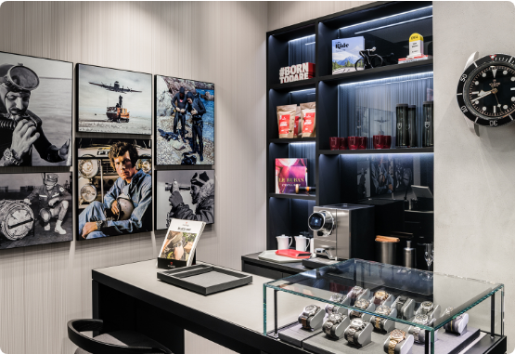
The Existing System
Drawbacks of Current Models:
▪
Physical Limitations: Brick-and-mortar stores are bound by time and geography, limiting potential revenue.
▪
Inadequate Role Management: Legacy systems lack dedicated "Staff" modules, forcing owners to share admin credentials.
▪
Generic Aesthetics: Standard e-commerce templates fail to capture the high-end branding required to sell luxury investments.
▪
Data Rigidity: Traditional databases require schema alterations just to add products with unique specifications.
Existing retail systems limit sales geographically and rely on rigid, outdated databases that make scaling a luxury brand digitally very difficult.

Slide 8
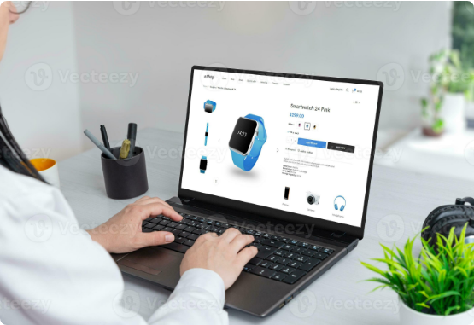
The Proposed Solution
Introducing WATCHERA:
▪
Modern SPA Architecture: Utilizing Angular to create a seamless, app-like experience without full-page reloads.
▪
Flexible Data Storage: Implementing MongoDB's NoSQL document structure to easily handle varying watch specifications.
▪
Strict Role Segregation: Custom modules designed specifically for Admin, Staff, and Customers to protect data.
▪
Premium Digital Branding: A sophisticated UI built with Tailwind CSS to perfectly match luxury guidelines.
Our proposed system, WATCHERA, solves these issues with a fast Single Page Application, a flexible NoSQL database, and strict user role management.

Slide 9
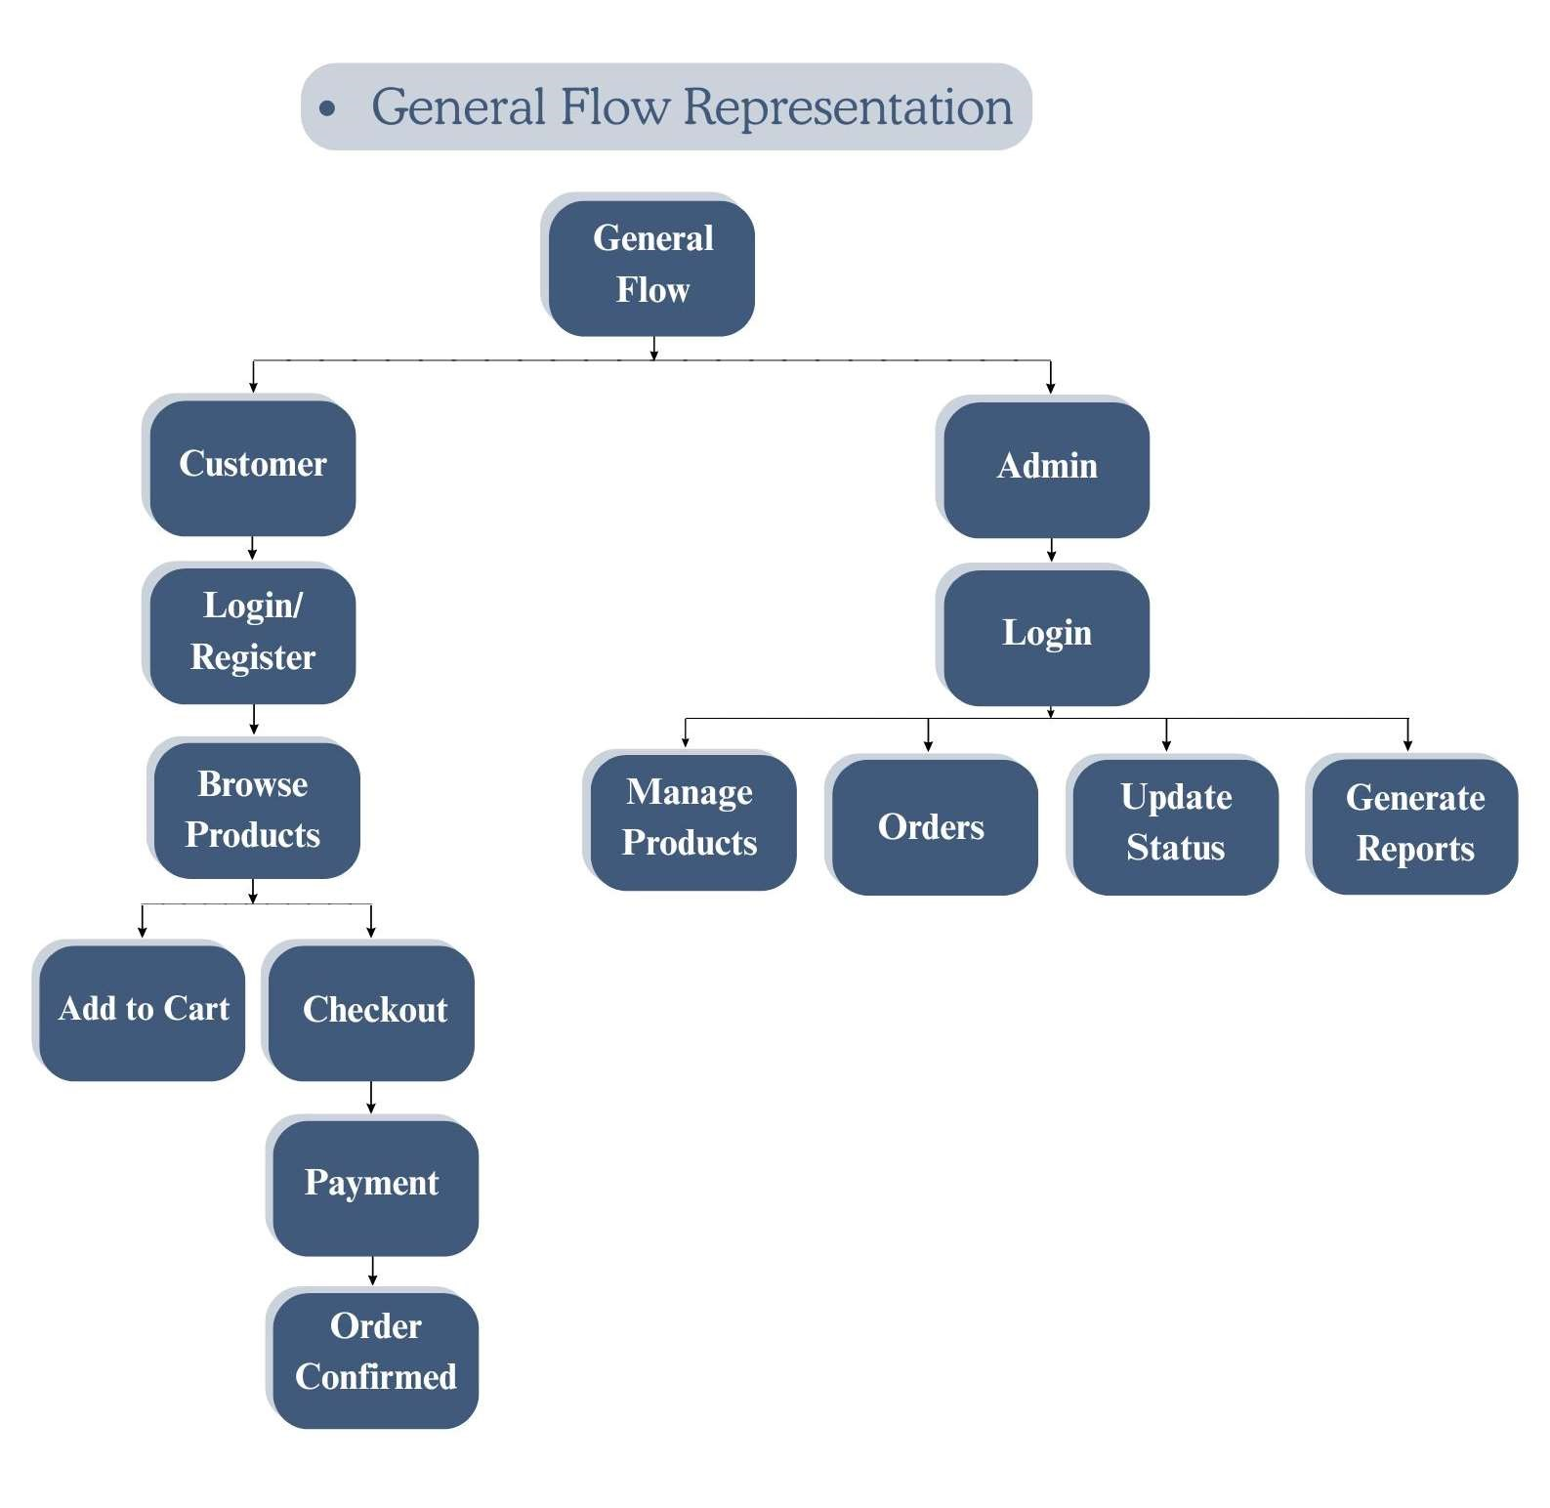
System Architecture
WATCHERA is built upon the robust MEAN Stack architecture:
Client Side (Front-End): Angular framework manages dynamic views, state, and user interactions, styled with Tailwind CSS.
Server Side (Back-End): Node.js provides the runtime environment while Express.js handles RESTful API routing and CORS security.
Database Layer: MongoDB (Atlas) stores schema-less JSON documents, allowing scalable storage for complex product catalogs and user data.
The architecture relies on the MEAN stack. The client is built with Angular, communicating via REST APIs to a Node/Express backend connected to MongoDB.

Slide 10








Core Technologies
Angular
Node & Express
MongoDB
Component-based framework for scalable Single-Page Applications (SPA).
Asynchronous runtime and minimalist framework for fast, secure REST APIs.
Flexible NoSQL database perfect for managing dynamic product specifications.
Tailwind CSS
Utility-first framework to rapidly design a visually sophisticated, responsive UI.
Our tech stack includes Angular and Tailwind CSS for the frontend, Node.js and Express.js for backend processing, and MongoDB for scalable data storage.

Slide 11


















Dataflow Diagram
Login / Registration
Browse Products
Admin Login
Search Products
Manage Products ( Add )
View Product Details
Manage Products ( Update )
Add to Cart
Add to Wishlist
Manage Products ( Remove )
Checkout
Manage Orders
Make Payment
Manage Customers
Manage Profile
View Reports
Logout

Slide 12
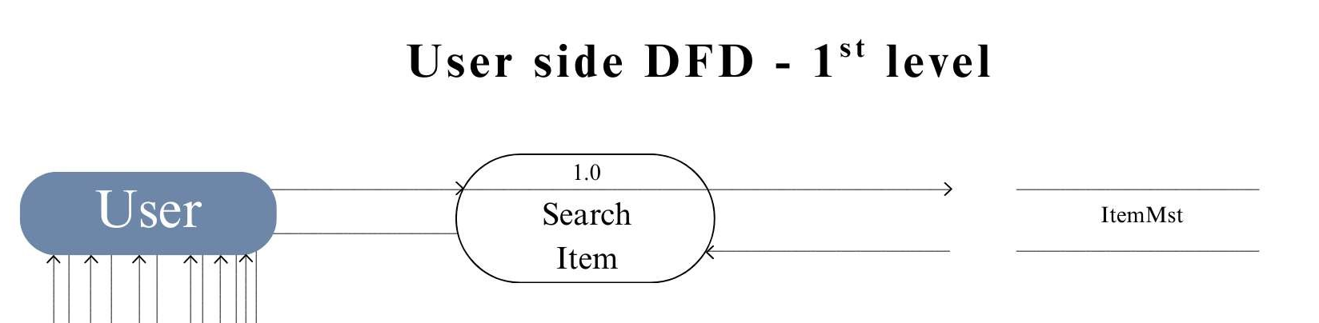
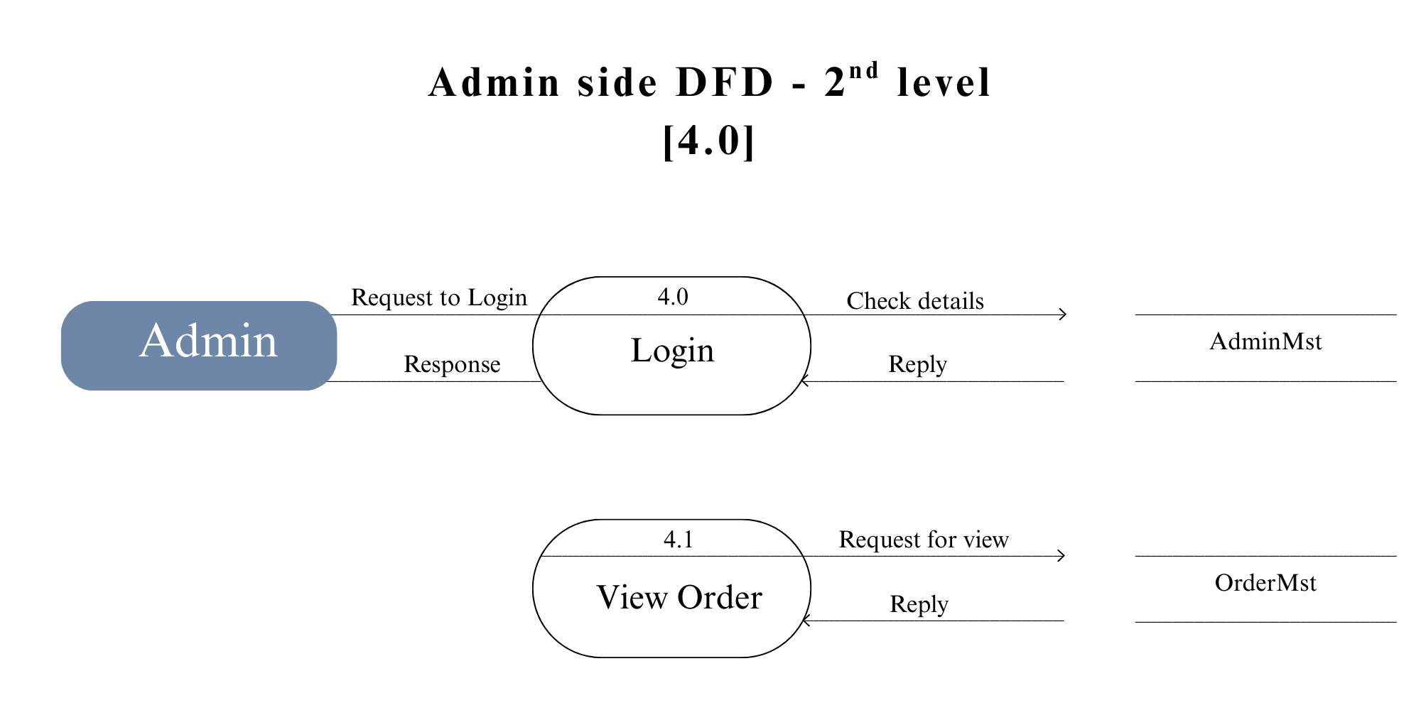
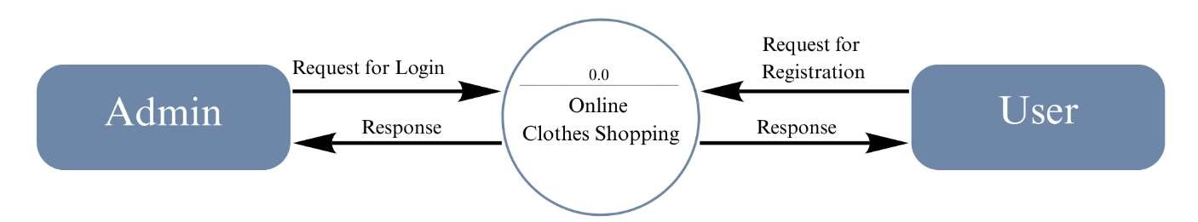
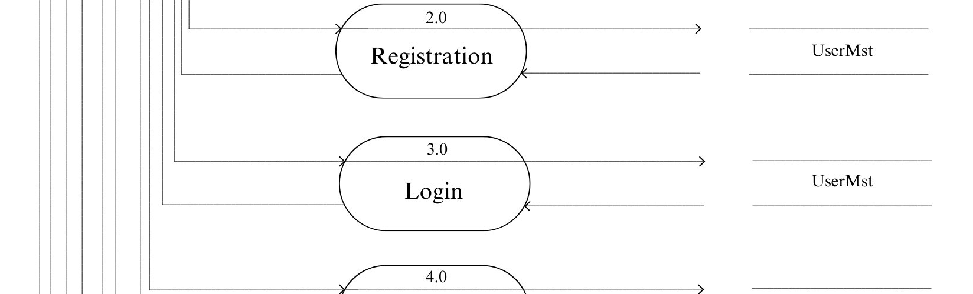
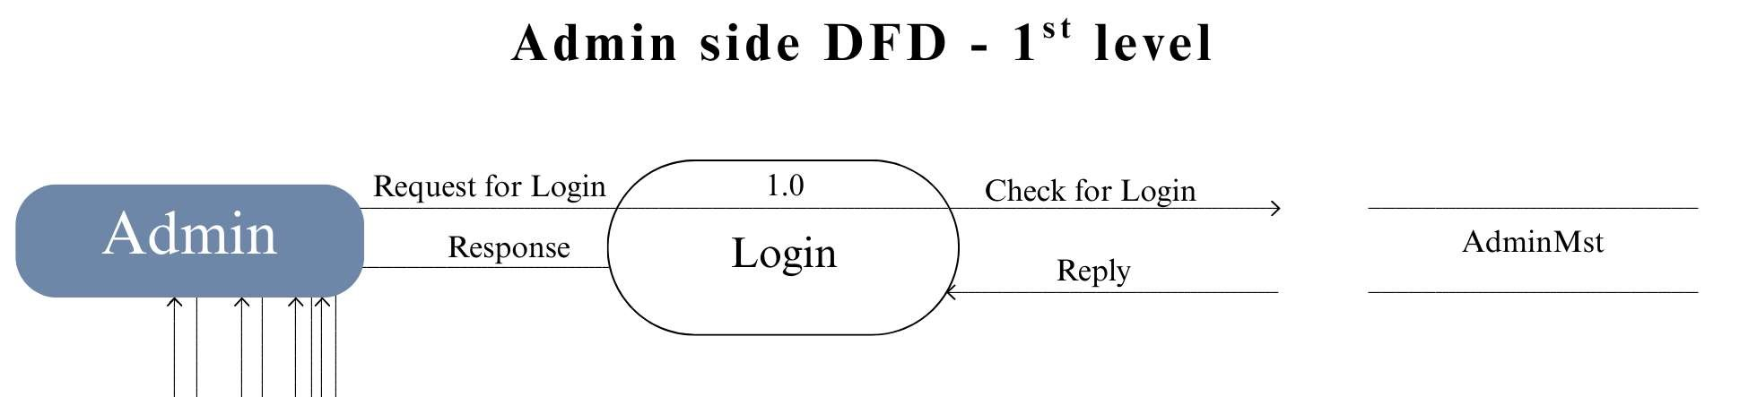
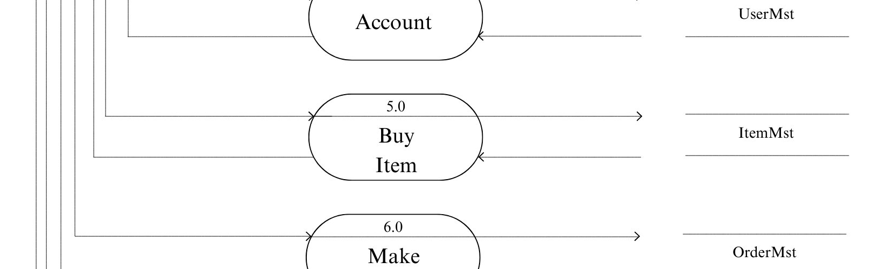
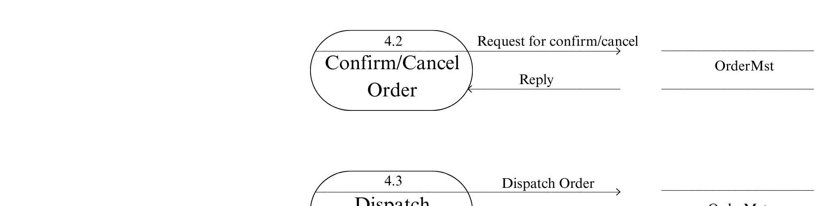
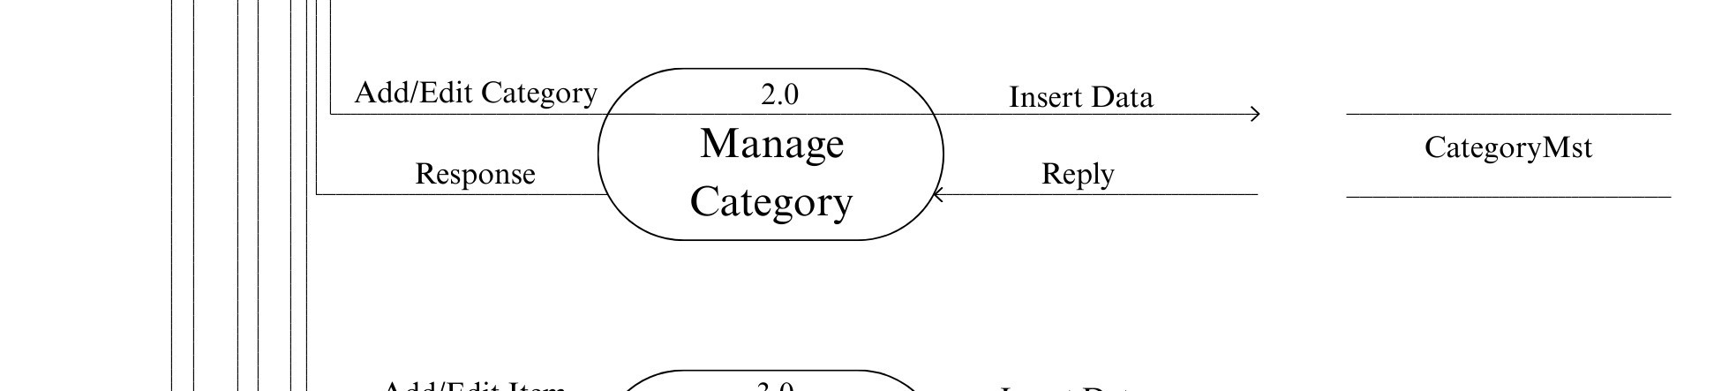
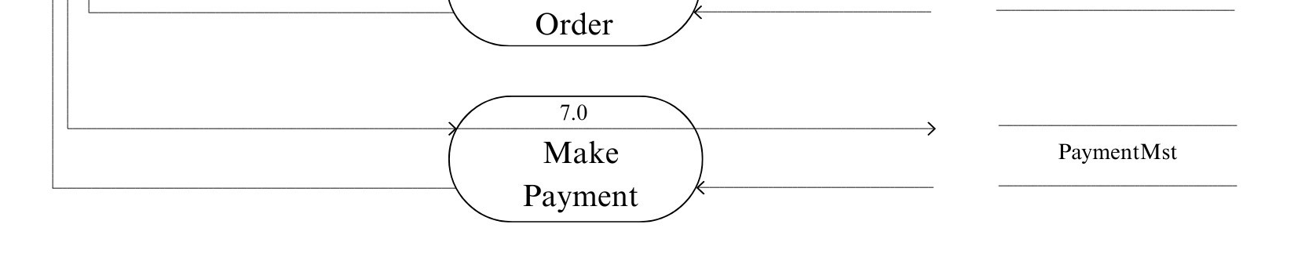
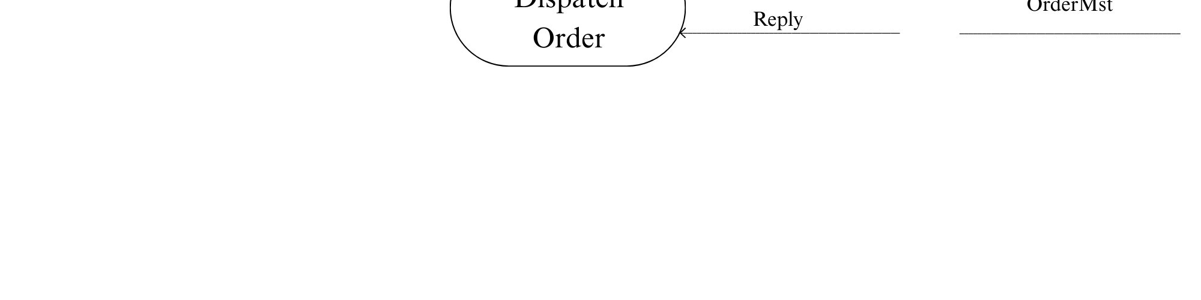
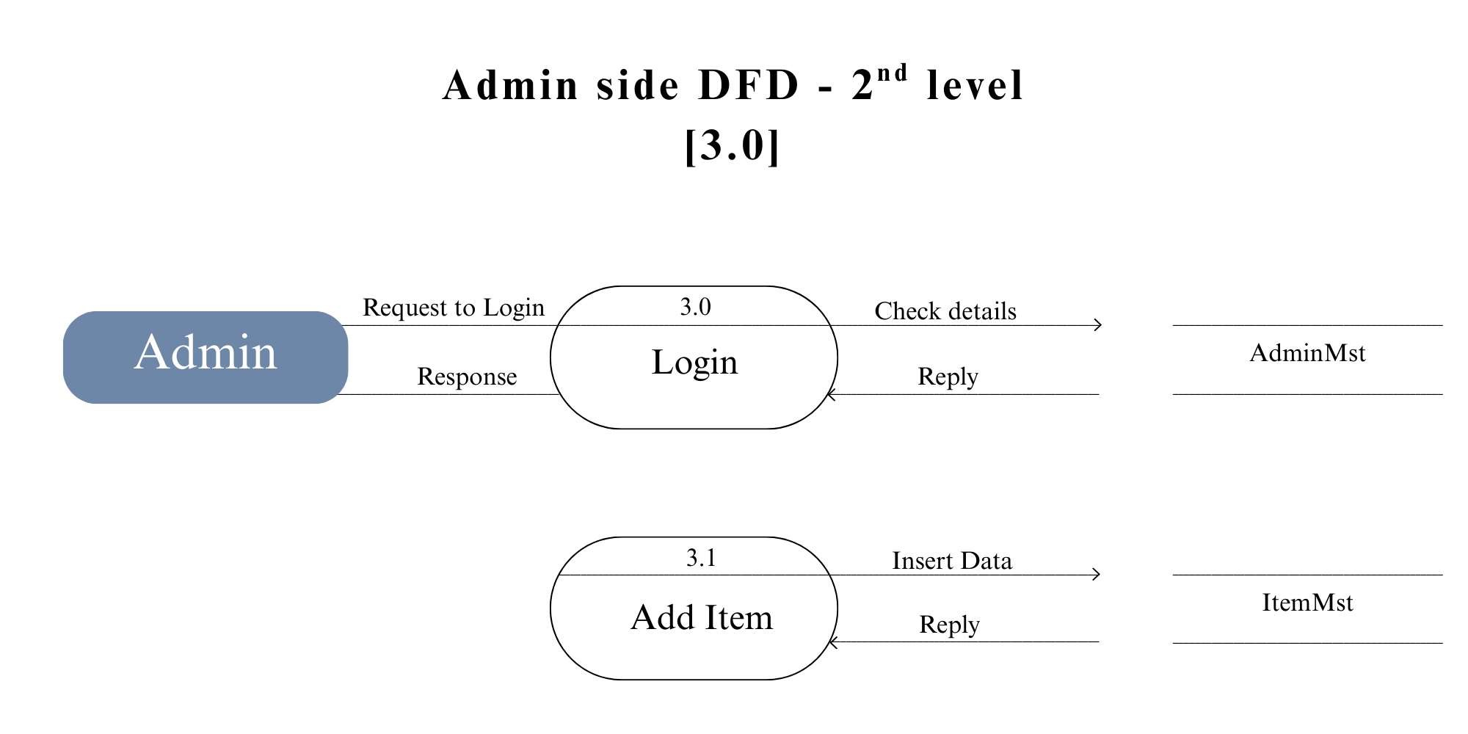
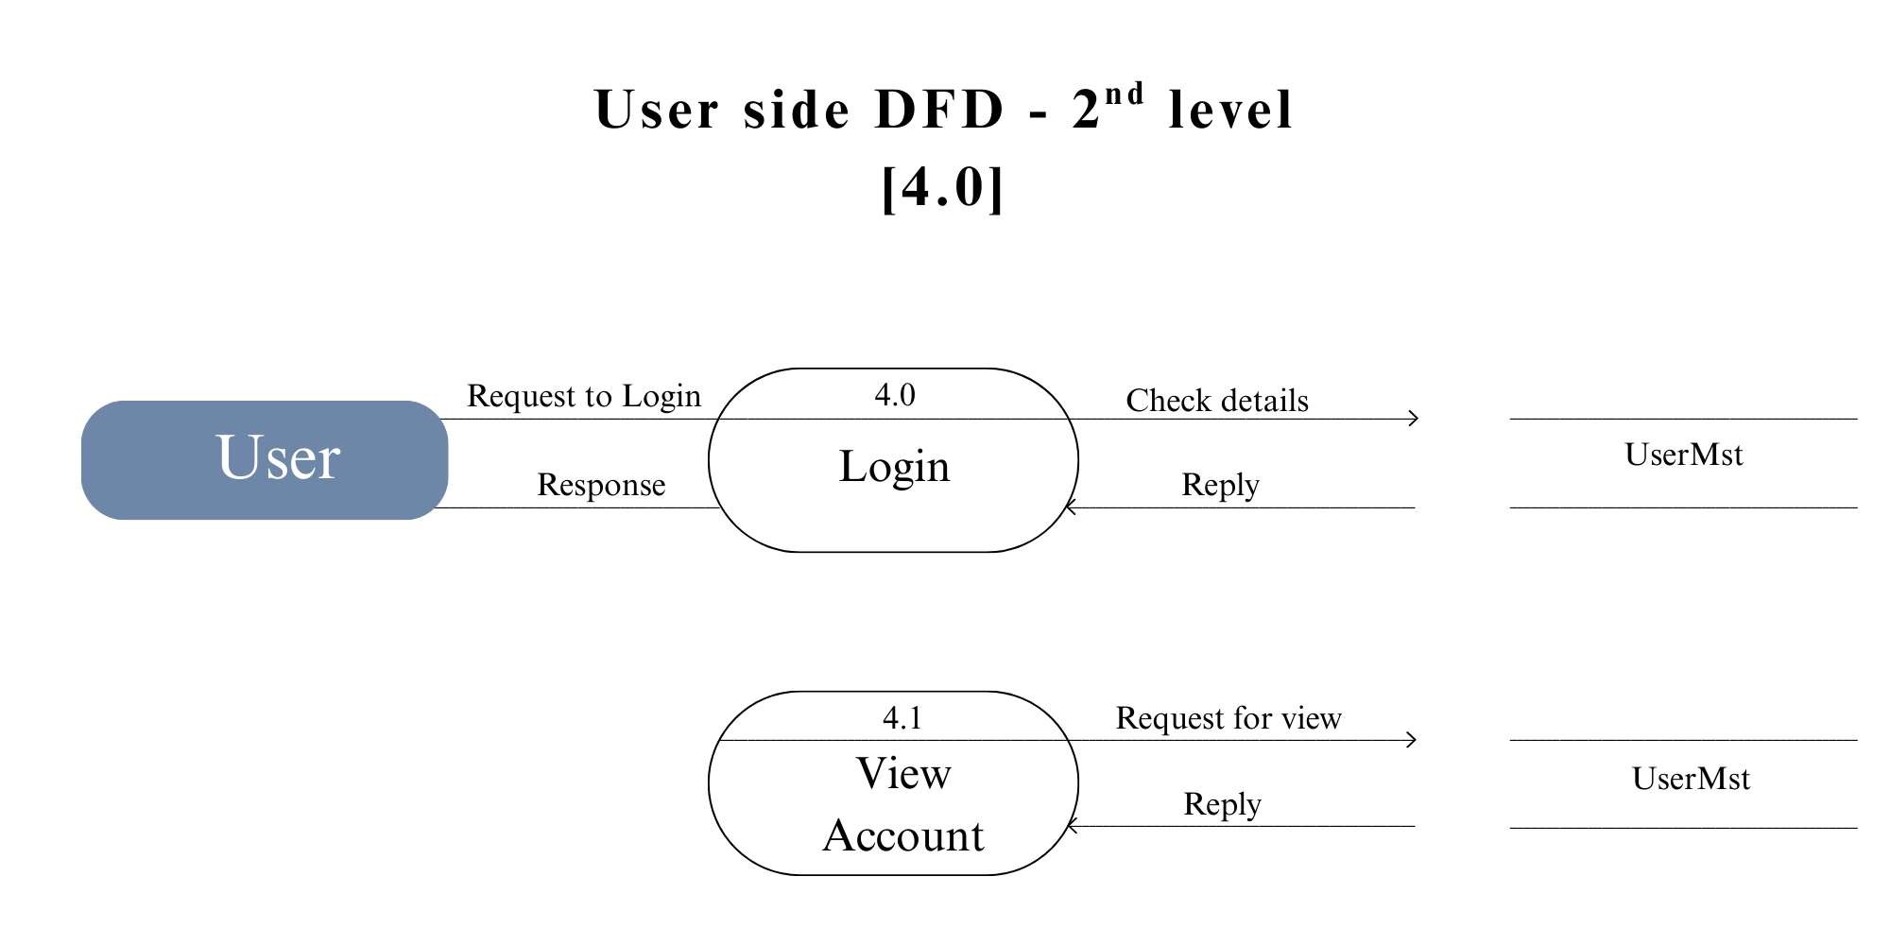
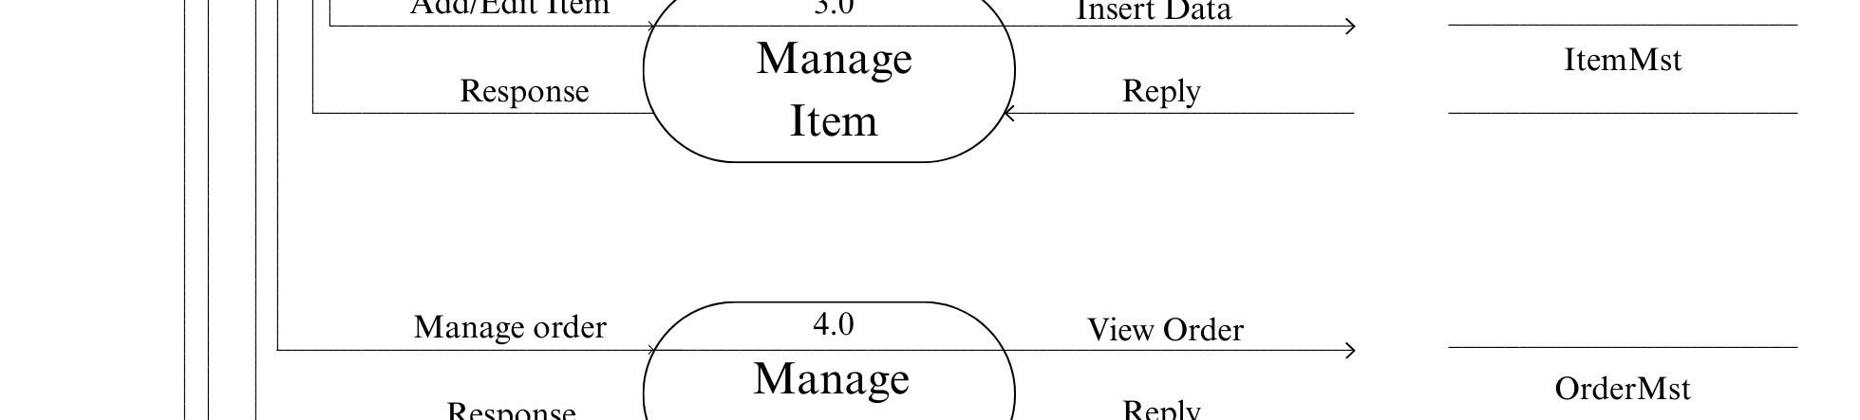
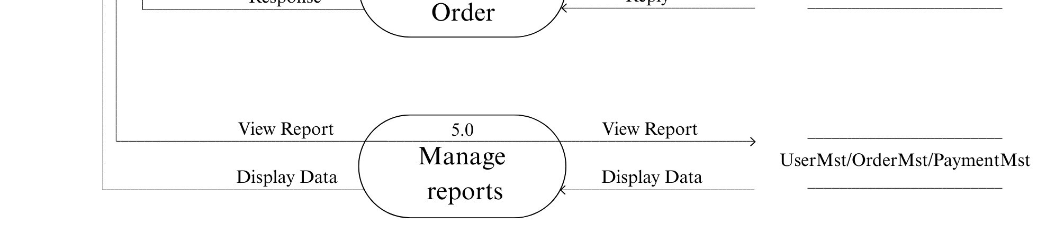
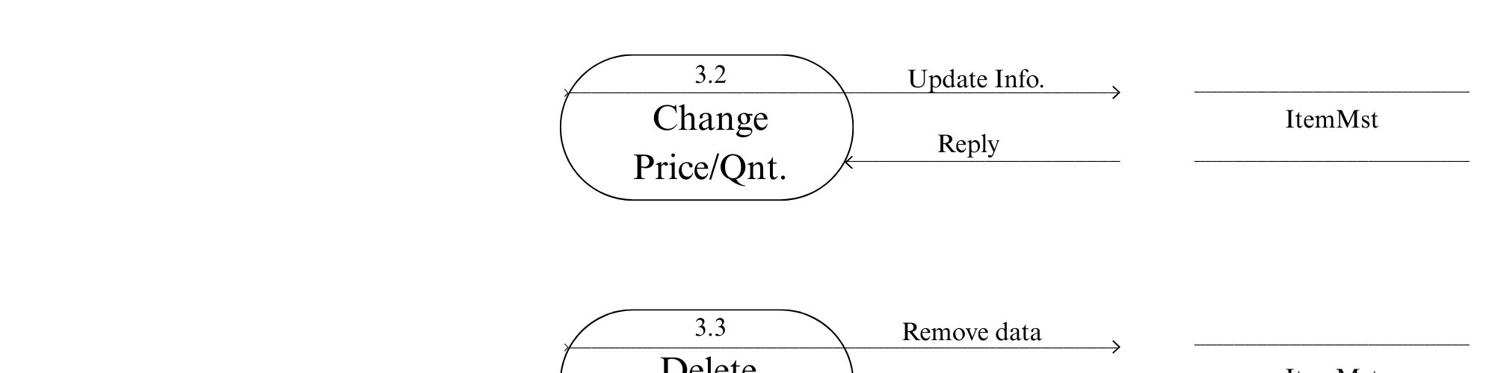
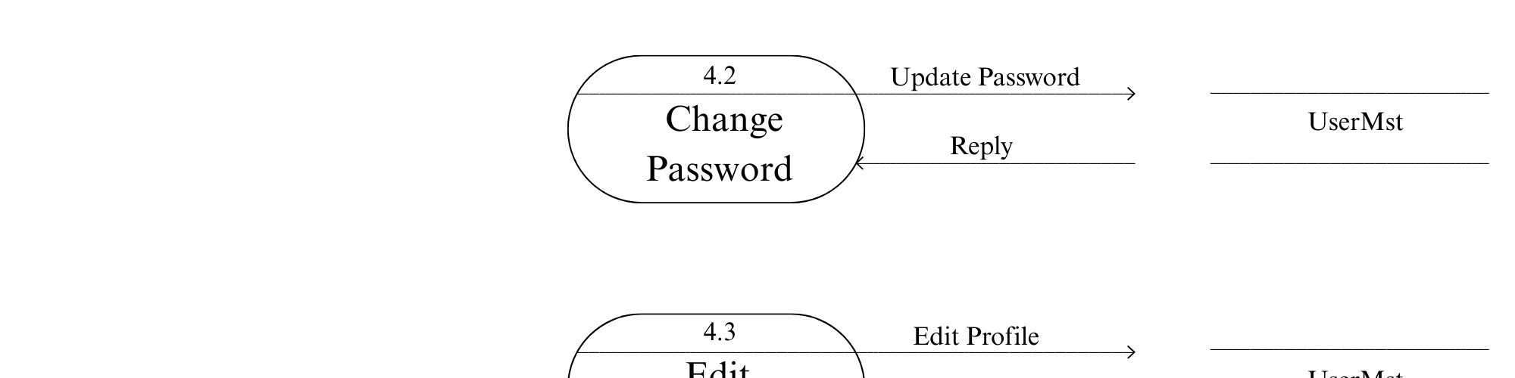
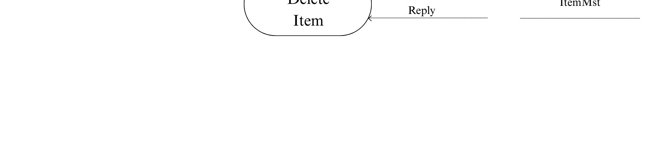
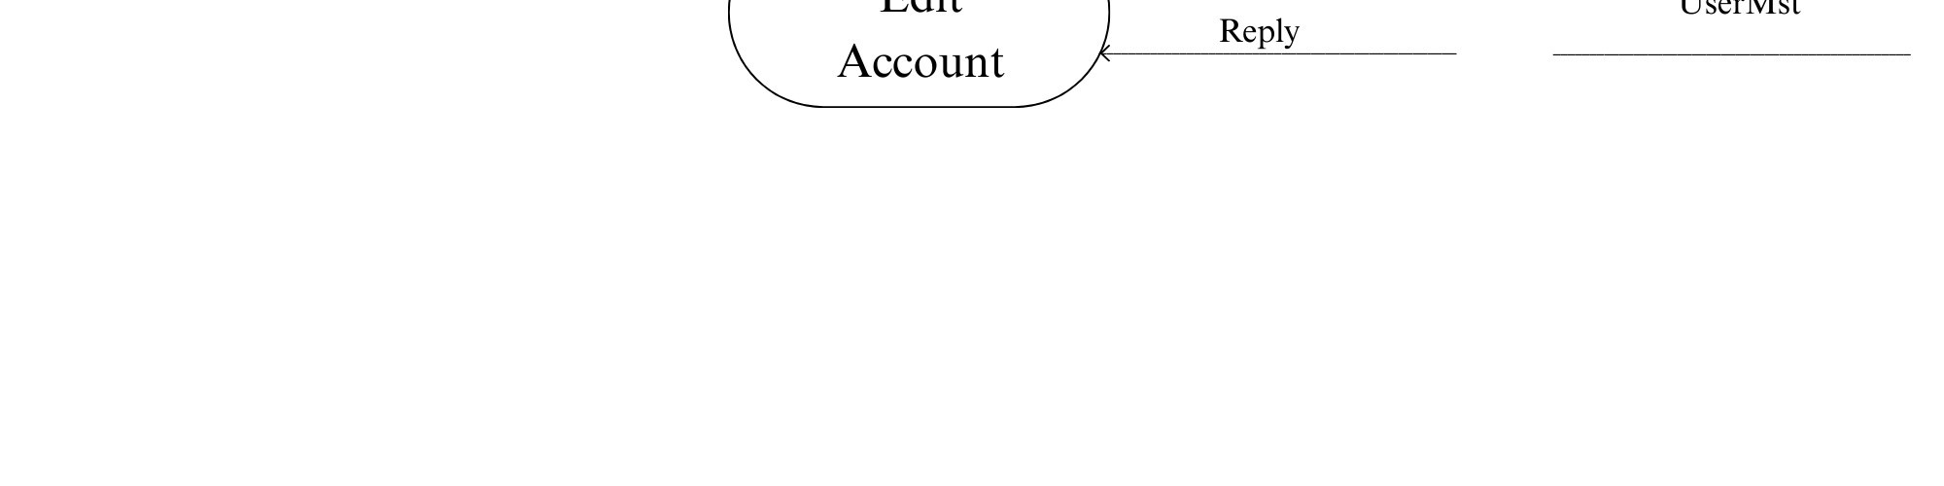
Context-level

Slide 13
Working Process & Methodology
We followed a structured System Development Life Cycle (SDLC):
6. Testing
2. Analysis
4. Designing
Validating modules for bugs and responsiveness.
Feasibility study and risk assessment.
Creating UI layouts with Tailwind CSS.
1. Gathering
3. Planning
5. Coding
Defining functional and non-functional requirements.
Designing UMLs, DFDs, and database schemas.
Integrating APIs with Angular frontend.
Our methodology strictly followed the SDLC phases: from gathering requirements and analyzing feasibility, to detailed planning, designing, coding, and testing.

Slide 14
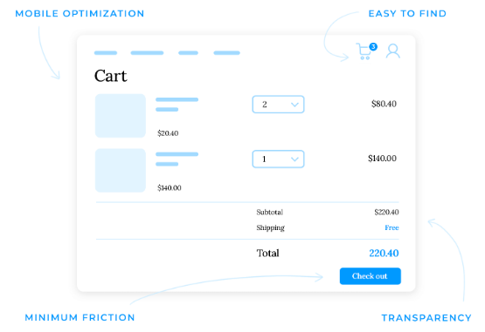
Customer Module Functionality
Product Search: Dynamic browsing with advanced filtering by brand, price, and movement type.
Cart & Wishlist: Reload-free shopping cart management and personal wishlist curation.
Secure Payment: Integration with secure payment gateways and transparent luxury tax calculation.
Order Tracking: Real-time tracking of fulfillment status and digital invoice downloads.
Reviews: Authenticated customers can submit verified star ratings to build community trust.
The customer module allows users to browse with dynamic filters, manage their cart seamlessly, process payments securely, and track their active orders.

Slide 15


Administrator Module Functionality
Dashboard Analytics
Catalog Management
Centralized view providing comprehensive business intelligence including total revenue, active orders, and customer acquisition metrics.
Full CRUD authority. Admins can add new watch models, upload high-res images, set dynamic pricing, and monitor real-time stock levels.
Order Fulfillment
User & Access Control
Complete oversight of the order lifecycle. Ability to verify payments, update shipping tracking numbers, and manage refund requests.
Manage all registered customer accounts and create restricted role-based access for delivery staff or support employees.
The admin module provides absolute control. The owner can view revenue analytics, manage the product catalog, oversee order fulfillment, and control user access.

Slide 16
Database Design (MongoDB Collections)
Collection | Key Fields (JSON Documents) | Purpose
User | _id, name, email, password (hashed), role, isActive | Manages authentication and role-based access.
Product | _id, name, brand, price, stock, images, specifications | Stores the dynamic luxury watch catalog data.
Order | _id, user_ref, items, shippingAddress, totalPrice, status | Tracks customer purchases and delivery status.
Cart | _id, user_ref, products Array(id, quantity) | Maintains persistent, reload-free shopping carts.
Coupons | _id, code, discountValue, expiryDate, isActive | Validates and applies promotional discounts.
We used MongoDB to store data in flexible JSON collections. The main tables include Users, Products, Orders, Carts, and Coupons, connected via Object IDs.

Slide 17
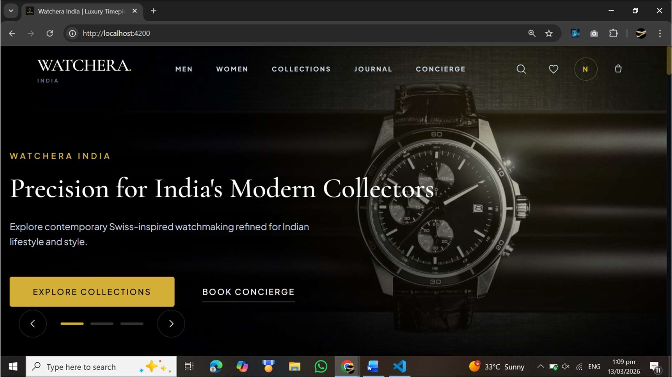
Implementation & UI Details
Component-Based: Developed reusable Angular components for product cards, navigation, and forms.
Premium Aesthetic: Utilized Tailwind CSS to establish a "dark mode" luxury theme accented with gold and crisp white.
Responsive Layout: Ensured the digital storefront adapts perfectly across desktops, tablets, and mobile devices.
Secure API Routing: Configured Express.js endpoints to securely handle data requests from the frontend.
During implementation, we built reusable Angular components and styled them with Tailwind CSS to ensure a responsive, dark-mode luxury aesthetic across all devices.

Slide 18

Results & Testing Outcomes
Quality Assurance Verified:
▪
Functional Testing: Verified that cart updates, secure checkout, and invoice generation operate flawlessly without errors.
▪
Integration Testing: Confirmed smooth data flow between the Angular frontend, Node API, and MongoDB database.
▪
Environment Testing: Successfully tested across major browsers (Chrome, Safari, Edge) and OS platforms.
▪
Performance Check: Optimized DB queries ensure fast loading of high-resolution product catalogs.
Our rigorous testing phase confirmed that the website functions perfectly. Database operations are accurate, the UI is responsive, and no critical errors were found.

Slide 19


Advantages of WATCHERA
Scalability & Speed
Unified Workflow
The combination of MongoDB's distributed database and Angular's SPA rendering easily handles high traffic and delivers a fluid, instant experience.
Utilizing a full JavaScript/TypeScript (MEAN) stack creates a highly efficient, seamless pipeline between backend APIs and frontend UI components.
Cost-Effective Security
Premium User Experience
Leveraging open-source technologies provides enterprise-level reliability and data security without prohibitive corporate licensing costs.
The system breaks away from generic templates, offering a highly customized, mobile-first design tailored for luxury clientele.
The key advantages of WATCHERA include high scalability, a unified JavaScript development workflow, cost-effective security measures, and a premium user experience.

Slide 20
System Limitations
Internet Dependency: The platform requires a stable, continuous internet connection to load high-resolution images and process real-time API requests.
Payment Gateway Reliance: Transaction completion is dependent on the uptime and latency of third-party payment providers (like Razorpay).
Image Size Constraints: Admin image uploads are restricted to 5MB to preserve optimal page load speeds.
Session Expiration: For security compliance, user authentication sessions automatically expire after 24 hours of inactivity.
Current limitations include a strict dependency on stable internet and third-party payment gateways, as well as necessary restrictions on image upload sizes.

Slide 21

Future Scope of Enhancements
3D Visual Try-On: Integrating AR features allowing customers to view how a watch looks on their wrist using their device camera.
Native Mobile Application: Converting the web app into a dedicated Android/iOS app with push notification capabilities.
AI Recommendations: Implementing AI to provide smart, algorithm-driven watch suggestions based on user browsing history.
Global Localization: Adding real-time currency conversion and multi-language support for international collectors.

Slide 22
Conclusion
"The development of the WATCHERA platform successfully demonstrates a highly functional, full-stack e-commerce solution that seamlessly bridges premium luxury retail with modern web convenience."
By successfully implementing the MEAN stack, we have established a solid, well-structured digital foundation. It reliably handles core e-commerce workflows and is fully capable of future scaling.
To conclude, WATCHERA effectively meets its goal of delivering a robust, secure, and visually stunning e-commerce solution using modern web technologies.

Slide 23
References
Angular Documentation: Official guides for component routing and SPA development. (https://angular.io/docs)
Node.js & Express API: Documentation for building asynchronous server backends. (https://nodejs.org/en/docs/)
MongoDB Manual: Reference for NoSQL database schema design and aggregation. (https://www.mongodb.com/docs/manual/)
Tailwind CSS Docs: Utility-first styling references for responsive design. (https://tailwindcss.com/docs)
MDN Web Docs: General reference for modern HTML, CSS, and JavaScript standards. (https://developer.mozilla.org/)
Here are the primary official documentations and resources we consulted during the development of this project to ensure we followed industry best practices.

Slide 24
Questions?
Thank you for your attention.
fenil.bhingradia@sdjic.edu | ronak.savsani@sdjic.edu | nand.avaiya@sdjic.edu
Thank you very much for your time. We would now be happy to answer any questions you may have about the WATCHERA project.

